Slide 1

We Have To STOP
Meeting Like This!
Virtual Collaboration with Employees and Partners
Beth Matteotti, Product Camp STL 2020

Slide 2
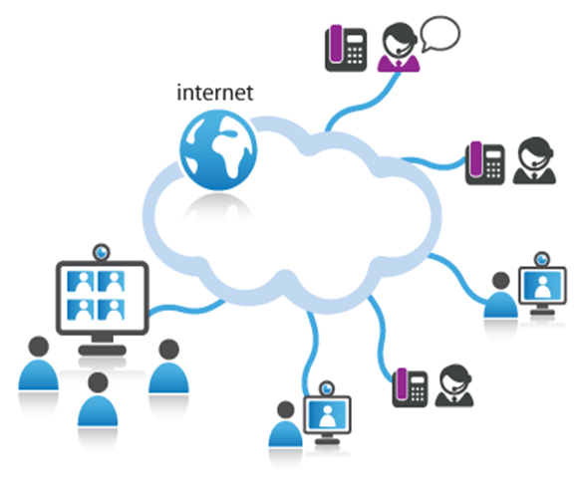
Workshop Agenda
  Review the challenges of remote collaboration
  Share some theory and brain science
  You will assess a typical collaboration
  Walk out with a written plan to improve collaboration

Slide 3

Notes:
Show of hands……how many of you typically facilitate/lead virtual meetings

Slide 4

Notes:
Show of hands……how many of you typically facilitate/lead virtual meetings

Slide 5
Types of Virtual Collaboration
virtual = remote = multi location = long distance

Slide 6
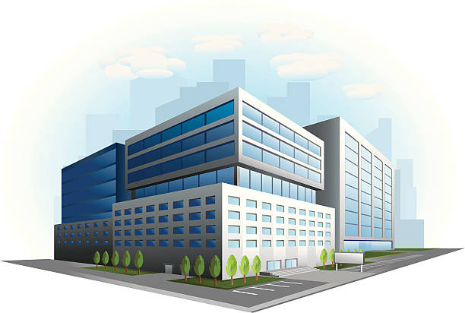

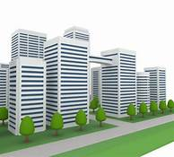
Types of Virtual Collaboration
virtual = remote = multi location = long distance
1. Collaboration happens between 2+ offices

Slide 7
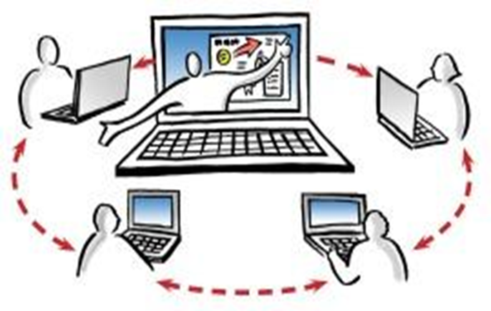
Types of Virtual Collaboration
1. Collaboration between 2+ offices
2. Nearly everyone is remote

Slide 8


Types of Virtual Collaboration
Collaboration between 2+ offices
Nearly everyone is remote
3. Only a few people are remote

Slide 9
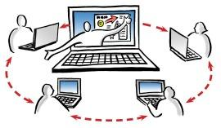
Virtual Collaboration - STATS
Virtual gatherings are on the rise
2/3 of people think the interaction quality is lower than face to face
73% admit to doing other work in meetings and 93% say that’s an obstacle
Training is non existent - 95%+ never trained
  *Sources: Atlassian.com, Forbes.com

Slide 10
Strategies depend on……
Number of people attending
Number of locations
Trust across participants
Technology available
  Basic features – video, desktop sharing, voice
  Advanced features - polling, whiteboard, chat, annotation, breakouts
Purpose and complexity of meeting

Slide 11

Why is this typically hard ??
PRACTICAL Reasons:
Training is non existent
Technology not being fully utilized
We’re distracted
Participants know you can’t see them!

Slide 12
Why is this typically hard???
PRACTICAL
Training is non existent
Technology not being fully utilized
Keeping them engaged
We’re distracted
Meeting quality expectations are lower
THEORY/SCIENCE
Communication is actually more seeing than hearing
People only collaborate with those they trust/ safe environment
Tough to build energy and creativity virtually
Brain Science

Slide 13
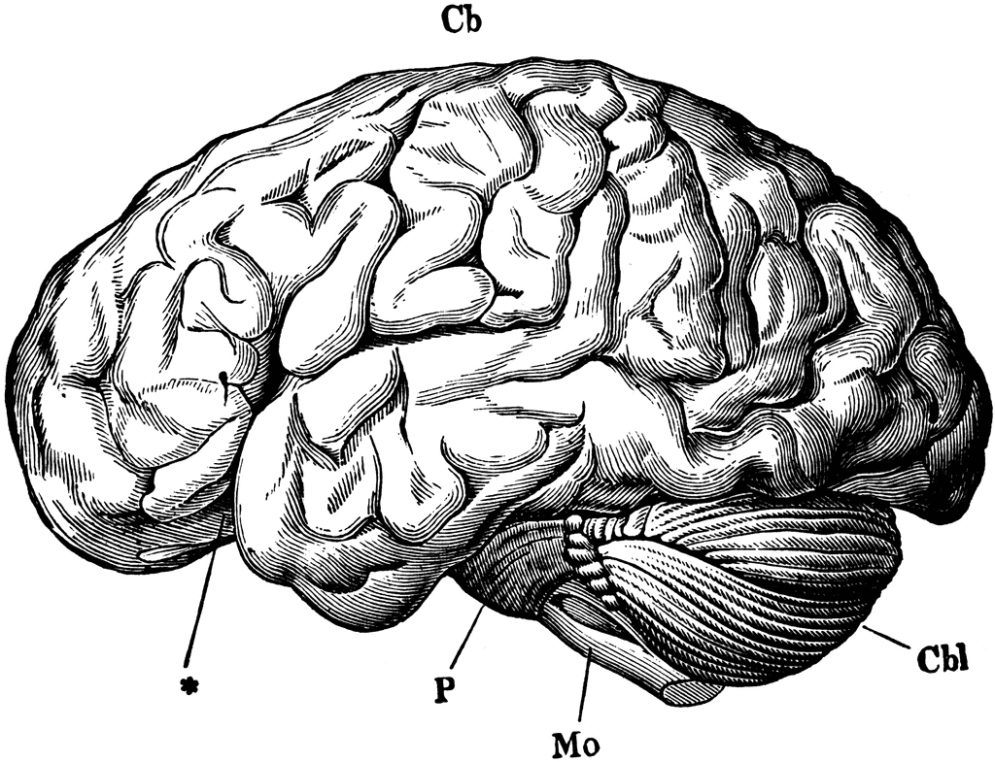
Brain Science
People can only focus for about 10 minutes*
*Brain Rules by John Medina
http://www.brainrules.net/attention
http://brainrules.net/sensory-integration
Notes:
One of the most important things he teaches is that audiences check out after 10 minutes, but you can keep grabbing them back by telling narratives or creating events rich in emotion.

Slide 14
Brain Science
People can only focus for about 10 minutes*
Retention/connection grows when integrate more senses
*Brain Rules by John Medina
http://www.brainrules.net/attention
http://brainrules.net/sensory-integration
Notes:
One of the most important things he teaches is that audiences check out after 10 minutes, but you can keep grabbing them back by telling narratives or creating events rich in emotion.

Slide 15

Now it’s your turn…..
EVALUATE a typical meeting
What themes emerge??

Slide 16
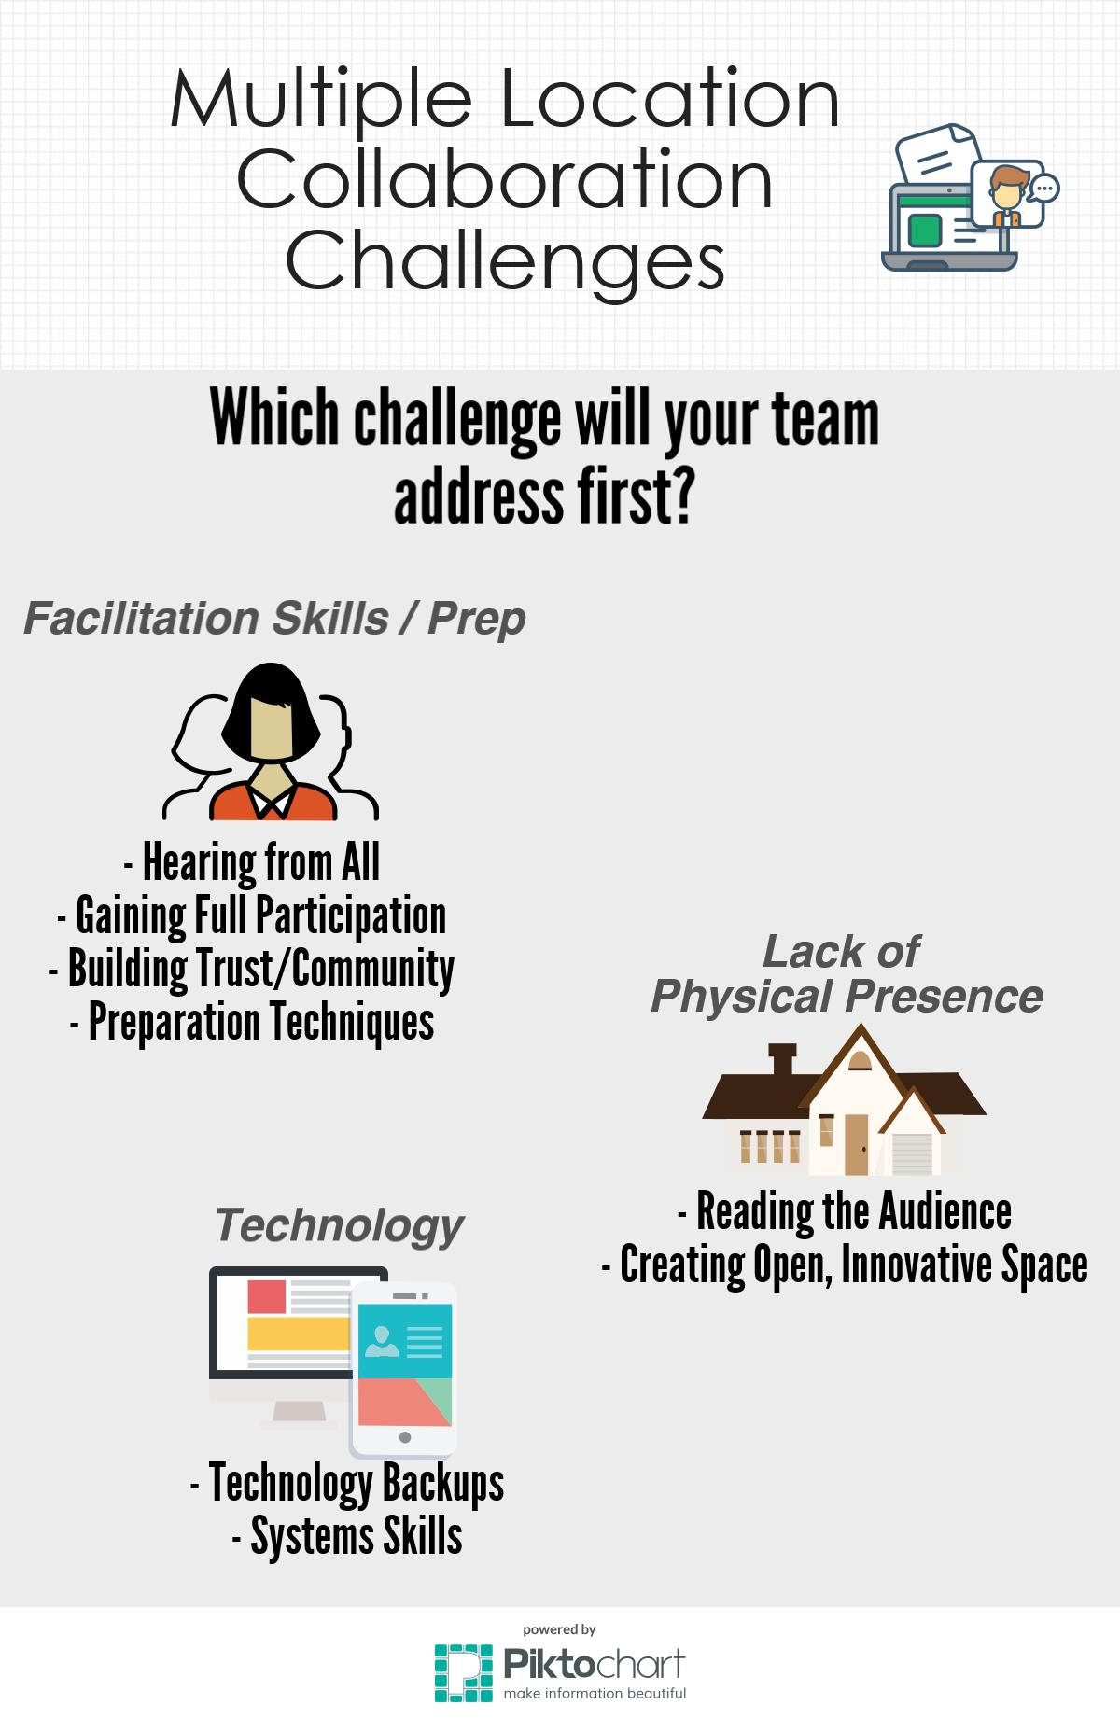
#1
#2
#3

Slide 17
Give everyone a job
Play favorites
Use Video
Close strong
Clear purpose
Be their eyes/ears

Slide 19

Other Ideas ?

Slide 20
Sign up to receive more tools

